Slide 1
Genome Rearrangement by Double Cut and Join
Jens Stoye
Bielefeld University, Germany

Slide 2
Outline
Genome evolution
Double Cut and Join (DCJ)
DCJ distance and sorting
Relation to other models
Insertions, deletions, substitutions
On the weight of indels
Summary and Conclusion

Slide 3
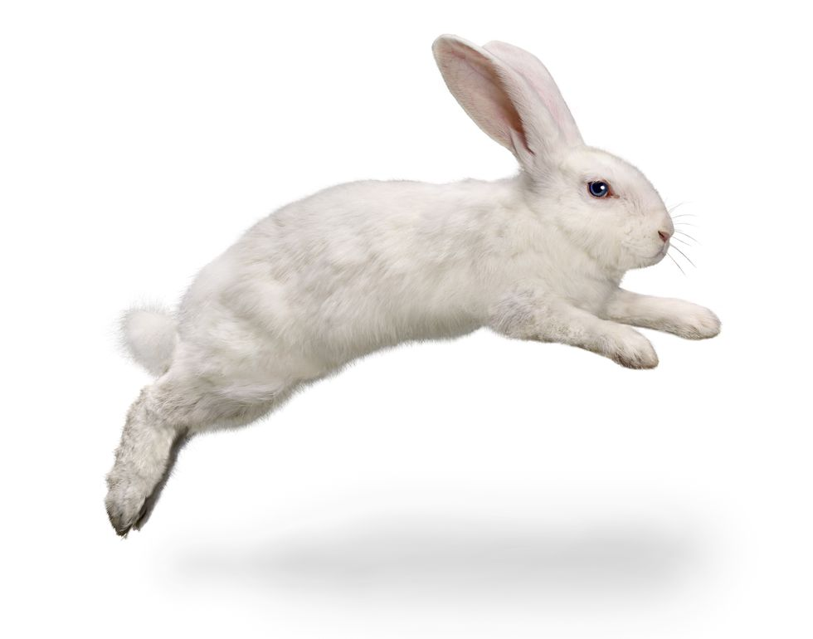

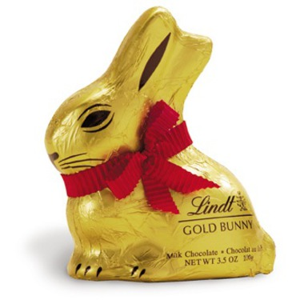
1. Genome evolution
Species change over time.

Slide 4
1. Genome evolution
At the molecular level:
Local vs. global modifications:
point mutations (sequence analysis)
large-scale operations (comparative genomics)
Local vs. global modifications:
point mutations (sequence analysis)
large-scale operations (comparative genomics)
Organizational vs. content-modifying operations:
rearrangement
insertion, deletion, substitution, duplication
Notes:
Arrows denote “blocks”, oriented markers, genes
Figure: DNA (breiter)
Figure: pointmutation
Figure: largescaleoperation
Figure: organizationaloperation
Figure: contentmodifyingoperation

Slide 5
Motivation
Evolution at the whole genome level:
Basic understanding of molecular processes at genomic scale
Evolutionary distances, phylogenetic trees (phylogenomics)
Ancestral genome reconstruction
Insights into gene function
Regulation of genes (e.g. operons in prokaryotic genomes)
Comparative genome assembly and annotation
Structural variations, cancer development, personalized medicine
Pathogen evolution, outbreak prediction, vaccination strategies
Notes:
Basic understanding …: microrearrangement, breakpoint reuse

Slide 6
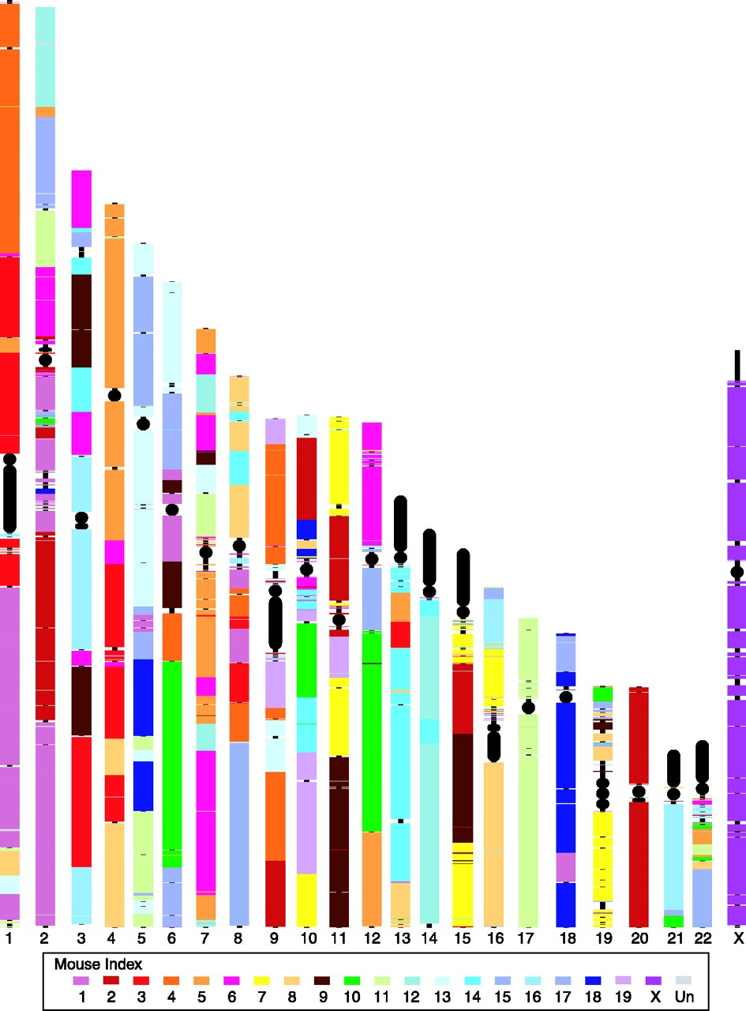
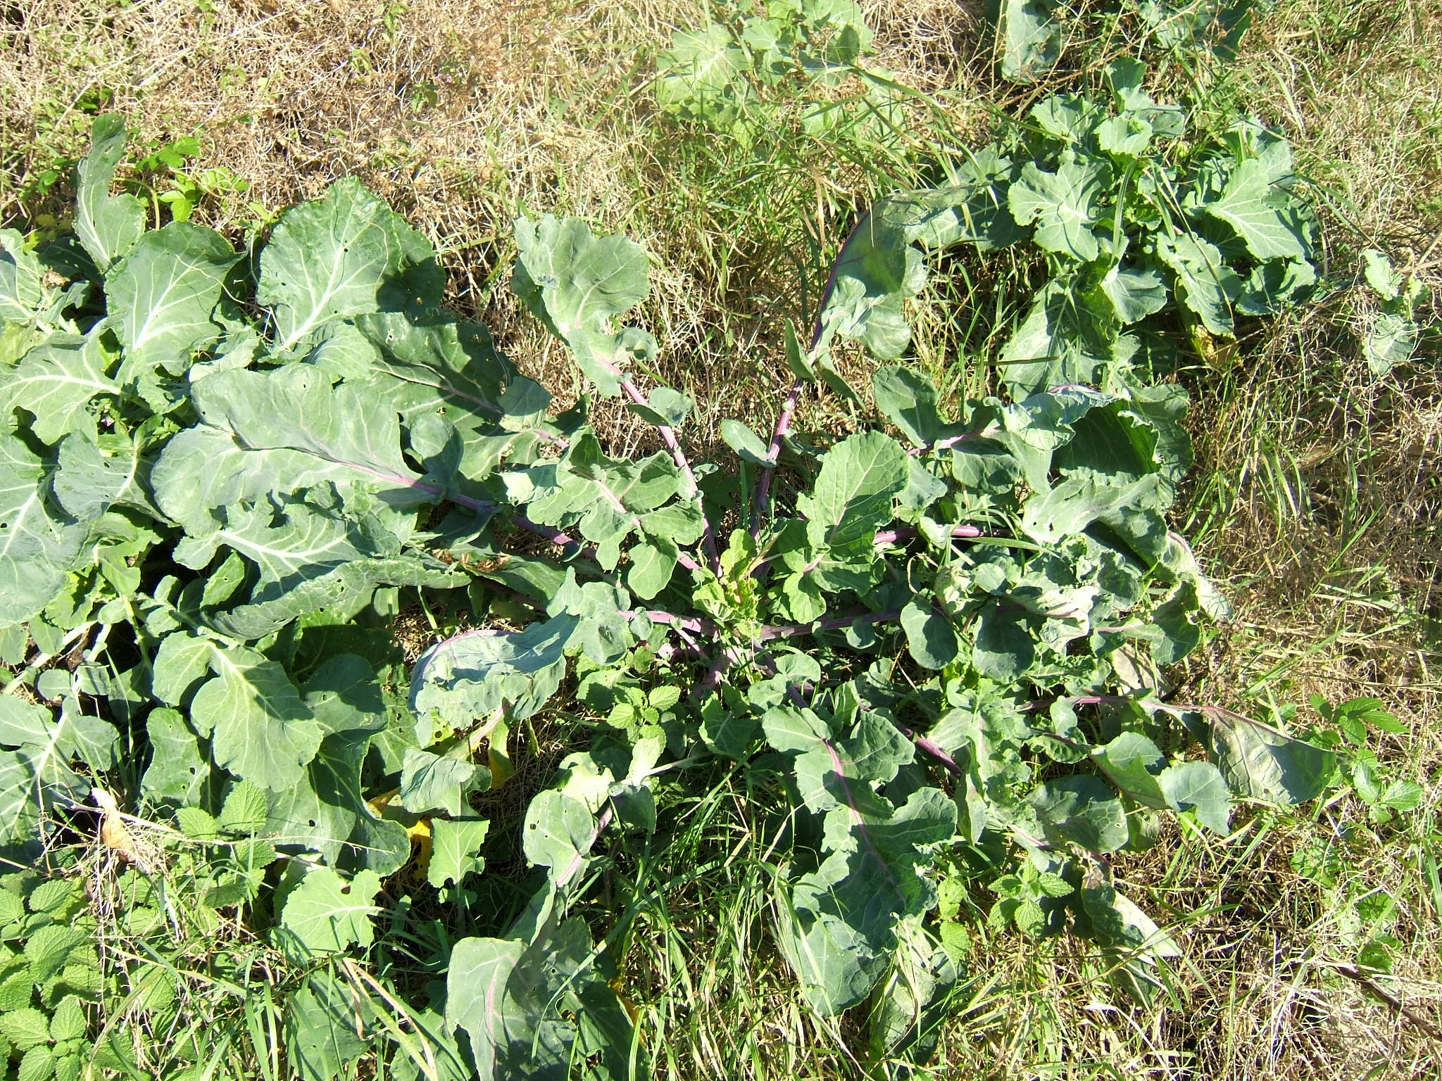
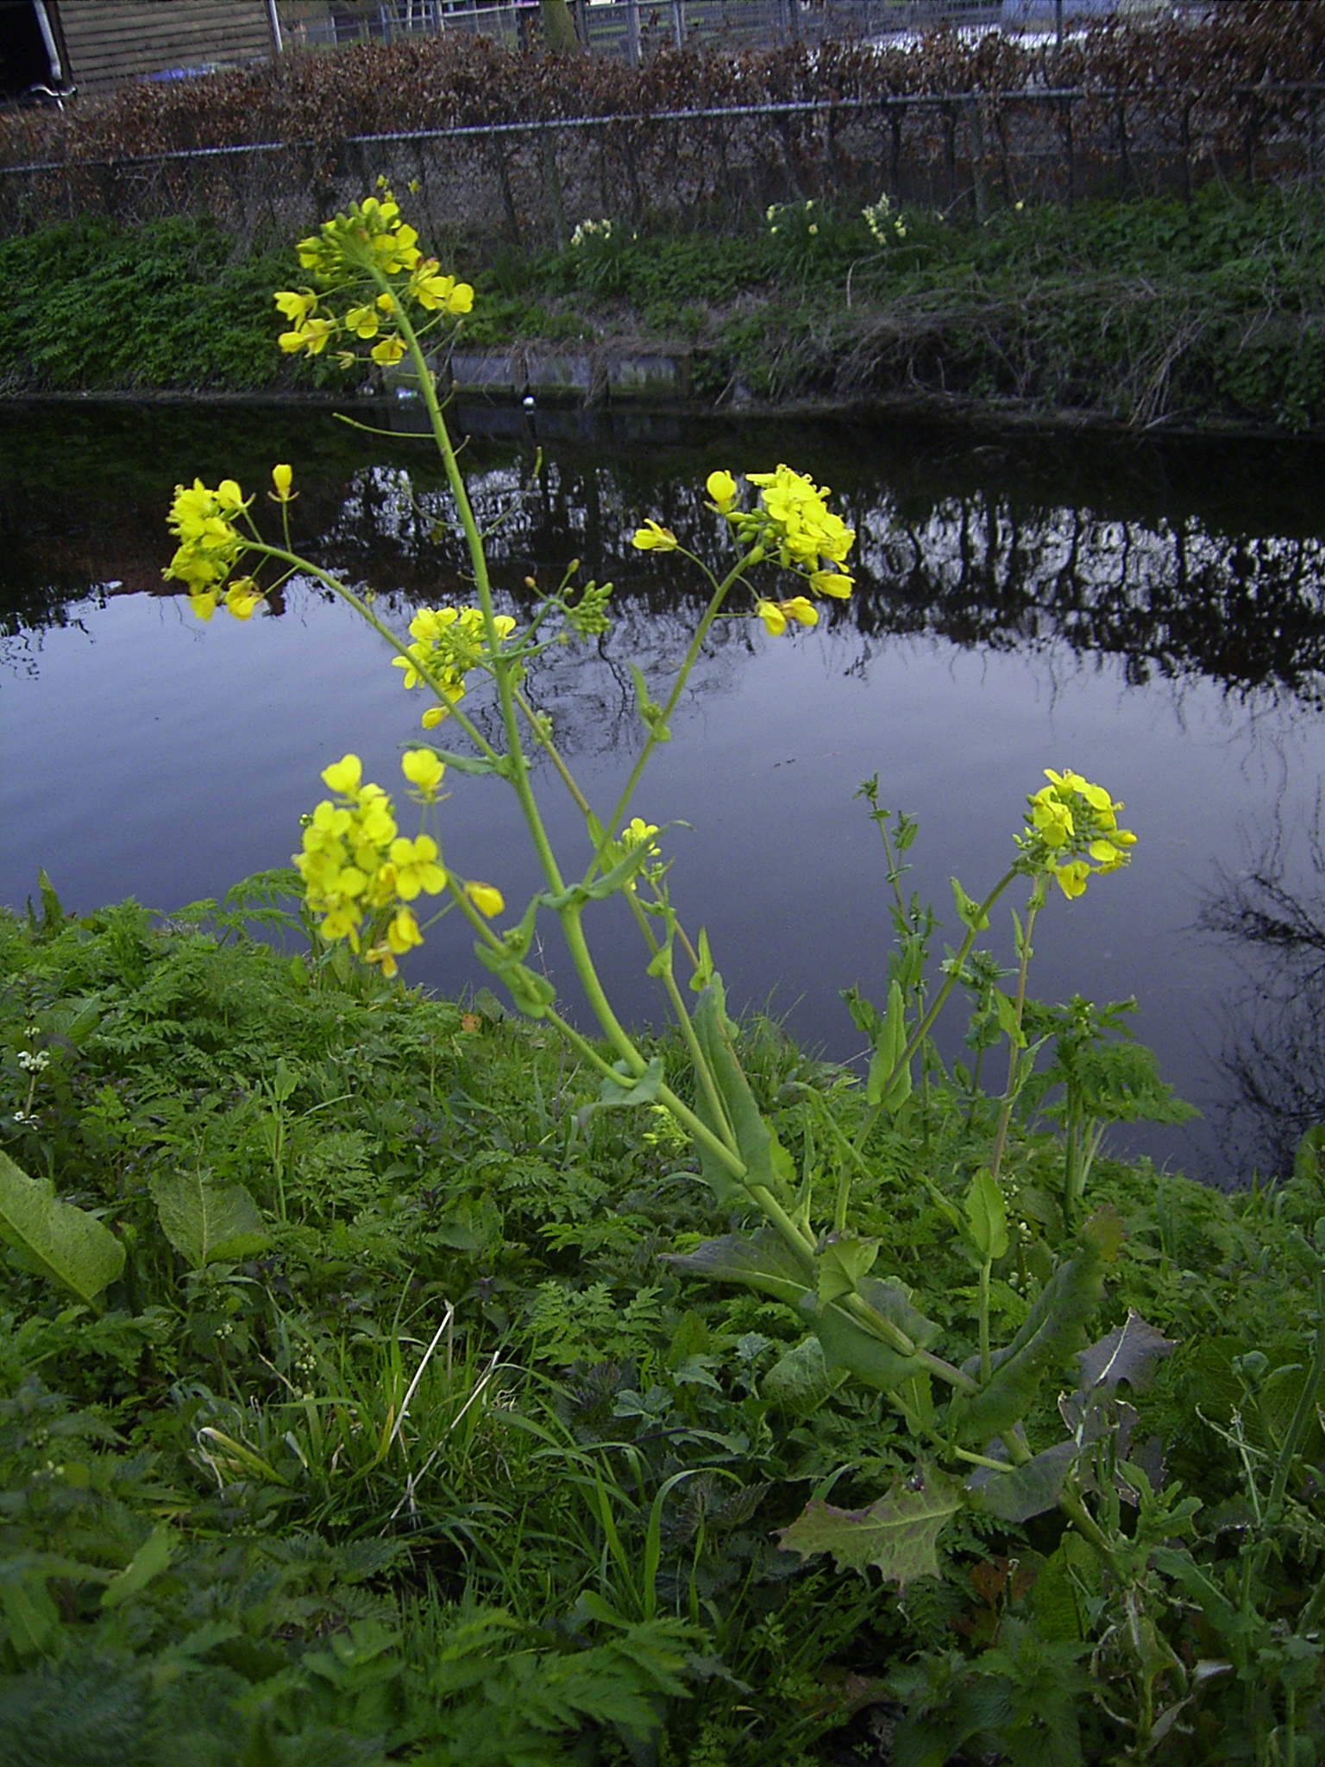
What happens in detail?
Figure: Palmer & Herbon 1988
Figure: Eichler & Sankoff 2003
Data from: Pevzner & Tesler 2003
Notes:
Brassica oleracea (cabbage; Salat)
Brassica campestris (modern: Brassica rapa: turnip, field mustard; wilder Senf)
Picture: PH1988-Figure3 (1-10) (unique putatively homologous oriented blocks of two plant mitochondrial genomes)

Slide 7
What happens in detail?
Basic rearrangement operations:
inversion
transposition
Note: 2-cut
(double-cut)
translocation
block interchange
fusion/fission
Assumption:
The number of rearrangements needed to transform one genome into another is a measure for the evolutionary distance between two species.
Notes:
Figure: inversion
Figure: transposition
Figure: translocation
Figure: blockinterchange
Figure: fusionfission

Slide 8
Questions to be asked:
How many rearrangement operations are needed?
distance d(A,B) ➔ “distance problem”
diameter problems
distribution of distances
halving distance
A
B
How much can we reconstruct of the past?
Ancestral genome(s)
rearrangement scenario(s) ➔ “sorting problem”
complete phylogenies
Notes:
Figure: distancequestions (folder: Operations)
Figure: reconstructionquestions (folder: Operations)
Picture: ES2003-Figure1
Picture: BMS2008-Appendix1

Slide 9
Some history (2 genomes)
Inversions (reversals):
Watterson et al. 1982; Sankoff 1992; Bafna & Pevzner 1993; Hannenhalli & Pevzner 1995; Kaplan, Shamir & Tarjan 1999; Bader, Moret & Yan 2001; Bergeron 2001; Bergeron, Heber & S 2002; Bergeron, Mixtacki & S 2004; Tannier, Bergeron, Sagot 2007
Translocations:
Hannenhalli 1996; Bergeron, Mixtacki & S 2005
Multichromosomal linear (“general HP model”):
Hannenhalli & Pevzner 1995; Tesler 2002; Ozery-Flato & Shamir 2003; Jean & Nikolski 2007; Bergeron, Mixtacki & S 2008; Erdős, Sokoup & S 2011
Double Cut and Join (DCJ):
Yancopoulos, Attie & Friedberg 2005; Bergeron, Mixtacki & S 2006; Kováč, Warren, Braga & S 2011
Other models:
Unsigned inversions: Kececioglu & Sankoff 1993; Christie 1998; Caprara 1999
Transpositions: Meidanis, Walter & Dias, 1997; Elias & Hartman 2006; Bulteau, Fertin, Rusu 2011
Inversions + Transpositions: Walter, Dias & Meidanis 1998; Christie & Irving 2001
Fusion/Fission + Transpositions: Meidanis & Dias 2001
Block interchanges: Christie 1996
Block interchanges + inversions: Mira & Meidanis 2007
Single Cut and Join: Bergeron, Medvedev & S 2010
Single Cut or Join: Feijão & Meidanis 2011
Notes:
YAF 2005: Burst into the field, explosion of new studies

Slide 10
Some history (2 genomes)
All models so far: Strong assumption that all genomes contain exactly the same set of blocks
Inversions + Insertions and Deletions:
El-Mabrouk 2001; Marron, Swenson & Moret 2004; Willing, Zaccaria, Braga & S 2013; Willing 2017
Insertions + Duplications:
Marron, Swenson & Moret 2004
DCJ + Insertions and Deletions:
Yancopoulos & Friedberg 2009; Braga, Willing & S 2010; Braga 2010; Braga, Machado, Ribeiro & S 2011b; Compeau 2012; da Silva, Braga, Machado & Dantas 2012; da Silva, Machado, Dantas & Braga 2012
DCJ + Insertions and Deletions + Duplications:
Yancopoulos & Friedberg 2009
DCJ + Substitutions:
Braga, Machado, Ribeiro & S 2011a

Slide 11
Towards formal modeling
Definitions:
Genome: set of chromosomes
Chromosome: sequence of oriented unique blocks (genes or other markers)
Independent dimensions:
Chromosome shape
  linear-only, (circular-only), mixed
Number of chromosomes
  unichromosomal, multichromosomal
Rearrangement operations
  single-cut, double-cut, (multi-cut)
Notes:
I will come back to this later ... (cube)
Figure: cube (1-3; see also slides 12, 19, 21, 29)

Slide 12
2. Double Cut and Join (DCJ)
(based on: Bergeron, Mixtacki & S: Proc. of WABI 2006)
The model we will concentrate on:
mixed linear and circular chromosomes
multichromosomal genome
2-cut operations
Notes:
Figure: cube (3-4; see also slides 11, 19, 21, 29)

Slide 13
Graphs with vertices of degree one or two
Definition:
The DCJ operation acts on two vertices u and v of a graph with vertices of degree one or two in one of the following ways:
If both u = {p,q} and v = {r,s} are internal vertices, these are replaced by the two vertices {p,r} and {s,q} or by the two vertices {p,s} and {q,r}.
If u = {p,q} is internal and v = {r} is external, these are replaced by {p,r} and {q} or by {q,r} and {p}.
If both u = {q} and v = {r} are external, these are replaced by {q,r}.
A single internal vertex {q,r} can be replaced by two external vertices {q} and {r}.
Notes:
Figure: dcjdefinition (1-9) (etwas vergrößert)

Slide 14
The formal problem
Definitions:
A block (marker, gene) a is an oriented sequence of DNA that starts with a tail a^{t} and ends with a head a^{h}.
Head and tail are called the extremities of a block.
An adjacency of two consecutive blocks a and b, depending on their respective orientation, can be of four different types:
{a^{h},b^{t}}, {a^{h},b^{h}}, {a^{t},b^{t}}, {a^{t},b^{h}}
An extremity that is not adjacent to any other block is called a telomere, represented by a singleton set {a^{h}} or {a^{t}}.
Genome: Set of adjacencies and telomeres such that the tail or head of a block appears in exactly one adjacency or telomere.
A = { {1^{t}}, {1^{h},3^{t}}, {3^{h},4^{h}}, {4^{t}}, {2^{h},5^{t}}, {5^{h},2^{t}}, {6^{t}}, {6^{h},7^{t}}, {7^{h}} }
Notes:
Figure: genome (see also slides 17, 18)

Slide 15
The formal problem
Two genomes:
A
B
DCJ Sorting Problem:
Given two genomes A and B with the same set of blocks, find a shortest sequence of DCJ operations that transforms A into B. The length of such a sequence is called the DCJ distance between A and B, denoted by d^{DCJ}(A,B).
Notes:
Figure: genome (see also slides 16, 18)
Figure: genomegraph

Slide 16
3. DCJ distance and sorting
(based on: Bergeron, Mixtacki & S: Proc. of WABI 2006; Braga & S: JCB 2010)
History of formal studies:
1992 – inversions (INV)
1995 – Hannenhalli-Pevzner (HP) model: inversions and translocations
1995 – translocations (TRL)
2005 – DCJ
→ surprisingly simple (in particular compared to the earlier results)

Slide 17
Adjacency graph
Definition:
The adjacency graph AG(A,B) is a graph whose set of vertices are the adjacencies and telomeres of A and B. For each u ∈ A and v ∈ B there are |u ∩ v| edges between u and v.
Related to breakpoint graph (Bafna & Pevzner 1993)
Notes:
Figure: adjacencygraph (1-8)

Slide 18
Transforming A into B
Adjacency graph
Notes:
Figure: sorting (1-24)

Slide 19
Algorithm
1: Let AG(A,B) be the adjacency graph of genomes A and B
// Generate the adjacencies of B that are not yet present in A
2: for each adjacency {p,q} in B do
3: let u be the vertex of A that contains p
4: let v be the vertex of A that contains q
5: if u ≠ v then
6: replace vertices u and v in A by {p,q} and (u \ {p}) ∪ (v \ {q})
7: end if
8: end for
//Generate the telomeres of B that are not yet present in A
9: for each telomere {p} in B do
10: let u be the vertex of A that contains p
11: if u is an adjacency then
12: replace vertex u in A by {p} and (u \ {p})
13: end if
14: end for
Analysis: O(N) time
where N = # of blocks

Slide 20
The DCJ distance
Theorem:
Let A and B be two genomes defined on the same set of N blocks, then we have
d^{DCJ}(A,B) = N – (C + I/2)
where C = # of cycles and I = # of odd paths in AG(A,B). A sorting sequence can be found in optimal O(N) time.
Example (Human-Mouse):
N = 281, C = 27, I = 16 ➔ d^{DCJ}(Human,Mouse) = 246
Note 1: Same as HP distance (no circular chromosomes necessary)
Note 2: Sorting scenarios can be of different types (1-cut vs. 2-cut operations)
Note 3: This can lead to different breakpoint reuse rates 0.89 ≤ r ≤ 1.51

Slide 21
The solution space of sorting by DCJ
(based on: Braga & S: JCB 2010)
There are really many rearrangement scenarios for a given pair of genomes:
Simplified case (k components with distances ℓ₁,…,ℓ_{k}):
General case: more complicated due to recombinations
1 component (distance ℓ) | number of scenarios
1 2 3 4 5 6 | 1 3 16 125 1296 16807
Notes:
Open question: closed formula for general case?
Figure: rearrangementscenarios (1-14)
Preamble: \usepackage{/Users/jstoye/tex/texinputs/sfmath}
Formula: S_{sep} \, = \, \frac{(\ell_1 + \ell_2 + \ldots + \ell_k)!}{\ell_1! \ell_2! \ldots \ell_k!} \times \prod_{i=1}^k (\ell_i + 1)^{\ell_i – 1}

Slide 22
4. Relation to other models
(based on: Bergeron, Medvedev & S: JCB 2010; Bergeron, Mixtacki & S: TCS 2009)
Hannenhalli-Pevzner (HP) model: 2-cut, linear-only, multichromosomal
Observation:
For two linear genomes A and B,
we have that
d^{DCJ}(A,B) ≤ d^{HP}(A,B)
In fact, for A = (1,3,2,4) and B = (1,2,3,4) we have d^{DCJ}(A,B) = 2 < 3 = d^{HP}(A,B).
Notes:
Figure: cube (5-7; see also slides 11, 12, 21, 29)
Figure: strongerexample (see also slide 29; breiter)

Slide 23
Relationship of distances
Unexpected asymmetry:
Notes:
Figure: cube (7-9; see also slides 11, 12, 19, 29)
Figure: unexpectedasymmetry
Arrow = stronger (there are genomes where e.g. HP uses more steps than DCJ), bullet = weakly equivalent (always same result, when applicable)

Slide 24
General HP distance problem
Sometimes HP needs more steps than DCJ: hurdle, fortress, knot, semi-knot, real-knot, semi-real-knot, weak-fortress-of-real-knots, etc.
Can we quantify this relative to DCJ?
d^{HP}(A,B) = d^{DCJ}(A,B) + t
Notes:
Figure: strongerexample (see also slide 19)
Figure: cube (9 verkleinert; see also slides 11, 12, 19, 21)

Slide 25
General HP distance problem
T’
Theorem:
If t is the cost of an optimal cover of T’, then
d^{HP}(A,B) = d^{DCJ}(A,B) + t
Closed formula for t (Erdős, Soukup & S: Appl. Math. Lett. 2011)
Linear-time algorithm for distance computation (Bergeron, Mixtacki & S: TCS 2009)
Similar result for inversion distance (Bergeron, Mixtacki & S: Proc. of CPM 2004)
Similar result for translocation distance (Bergeron, Mixtacki & S: JCB 2006)
Notes:
Figure: componentsgenomes (vergrößert)
Figure: components
Figure: tree (1-2)

Slide 26
Restricted DCJ
(based on: Kováč, Warren, Braga & S: JCB 2011)
Original motivation for DCJ (Yancopoulos, Attie & Friedberg 2005):
block interchange in 2 steps (instead of 3 as in the INV model)
Observation:
We need never more than 1 circular chromosome at a time, d^{rDCJ}(A,B) = d^{DCJ}(A,B).
Algorithmic results: Distance calculation in O(N) time
Sorting in O(N log N) time [lower bound?]
Notes:
Open question: is O(N log N) a tight bound?
Figure: restrictedDCJ (1-2): 1-INV, 2-DCJ

Slide 27
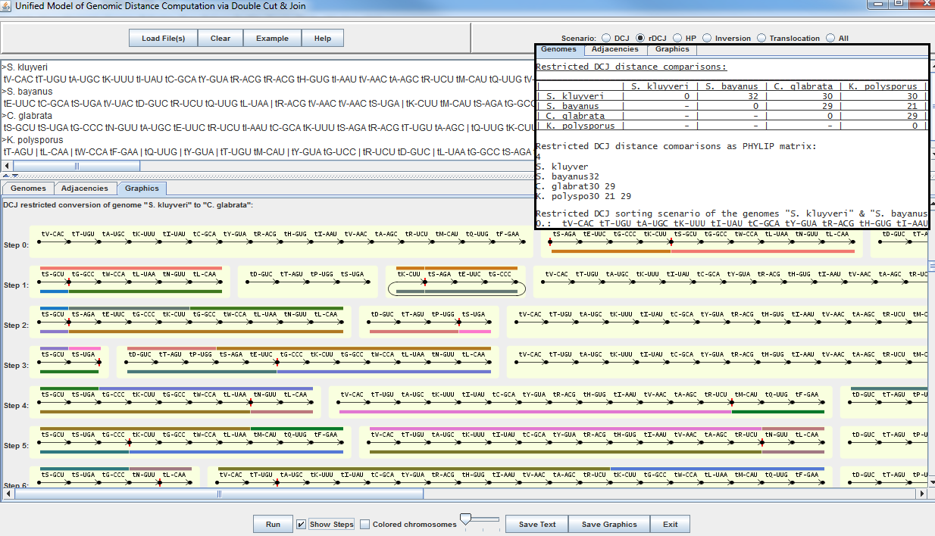
Software: UNIMoG
Screenshot: unimog
(Hilker et al.: Bioinformatics 2012; http://bibiserv.techfak.uni-bielefeld.de/dcj)
Notes:
Picture: HSPS2012-Figure1

Slide 28
Further applications of the DCJ model
Estimating the true evolutionary distance:
Lin & Moret 2008
Perfect rearrangement:
Bérard, Chateau, Chauve, Paul, Tannier 2008
Genome halving:
Warren & Sankoff 2008; Mixtacki 2008; Thomas, Ouangraoua & Varré 2012
DCJ Median:
Xu & Sankoff 2008; Lenne et al. 2008; Zhang, Arndt & Tang 2009; Xu 2009; Aganezov & Alekseyev 2012; Feijão 2015
Multiple genome rearrangement:
Adam & Sankoff 2008; Kováč, Brejová & Vinař 2011

Slide 29
5. Insertions, deletions, substitutions
(based on: Braga, Willing & S, JCB 2011)
So far: Only organizational operations
Now: Mixture of organizational and content-modifying operations
History:
Inversions + indels: El-Mabrouk 2001; Marron, Swenson & Moret 2004; Willing, Zaccaria, Braga & S 2013, Willing 2017
Here:
DCJ + indels: Yancopoulos & Friedberg 2008; Braga, Willing & S 2010; Braga 2010; Braga, Machado, Ribeiro & S 2011b; Da Silva, Braga, Machado & Dantas 2012
Again, the results in the DCJ model are much simpler than in INV or HP.
But we also run into modeling questions, as we will see later.

Slide 30
Insertion/Deletion
Extended model: Genomes with possibly unequal gene content
Unique blocks: Blocks occurring in only one of the two genomes
DCJ-indel distance:
Given two genomes A and B, find the minimum number of steps
(DCJ and indel operations) d^{DCJ-id} (A,B) necessary to sort A into B.
We consider: cost for 1 insertion = cost for 1 deletion = cost for 1 DCJ
Notes:
Figure: indel (folder Operations; vergrößert)

Slide 31
The DCJ-indel model
Saving indel operations:
Group unique blocks during sorting ➔ less indel operations
Notes:
Figure: savingindels (1-3; vergrößert)

Slide 32
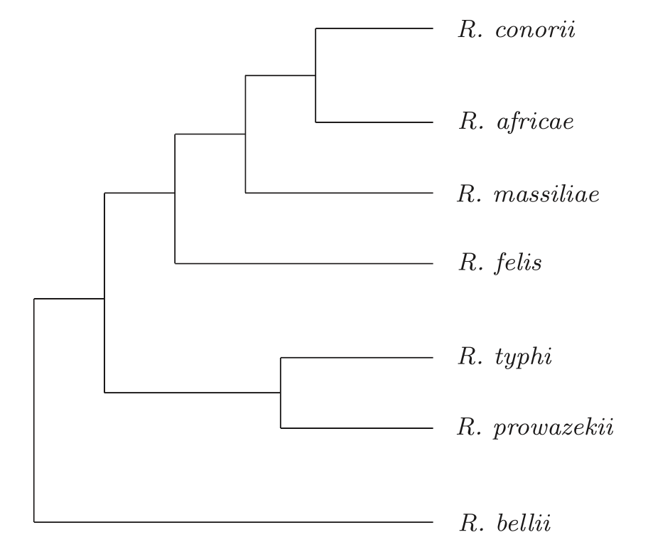
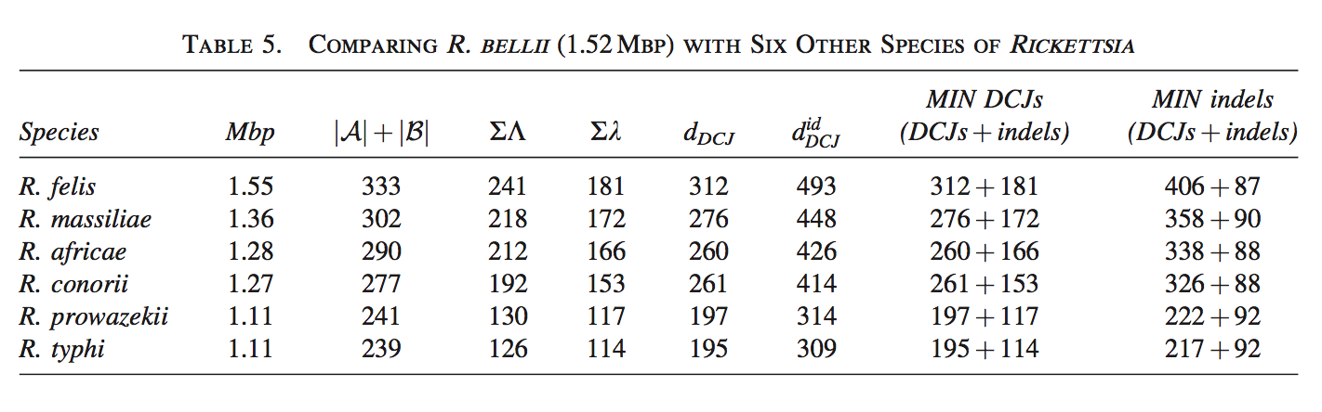
The DCJ-indel model
Result:
Theorem:
Given two genomes A and B, d^{DCJ-id}(A,B) and a shortest sorting scenario can be computed in linear time O(|A|+|B|).
In fact, indels can be traded for DCJ operations, for example:
Notes:
Preamble: \usepackage{/Users/jstoye/tex/texinputs/sfmath}
Formula: d^{DCJ-id}(A,B) \,\, = \,\, d^{DCJ}(A,B) \,\, + \!\! \sum_{C \in AG(A,B)} \!\!\!\! \lambda(C) \,\, - \,\, W
Table 5 from BWS 2011-Table5
Figure: BWS2011-Figure8

Slide 33
6. On the weight of indels
(based on: Braga, Machado, Ribeiro & S: BMC Bioinformatics 2011b)
Observation (Yancopoulos & Friedberg 2009):
When indel operations of multiple blocks are allowed, the triangle inequality may be disrupted.
Question: Is there a distance definition that does not disrupt the triangle inequality?
Notes:
Not a problem in pairwise comparisons
BUT: might be problematic in phylogenetic reconstructions or median problems
Figure: triangledisruption (1-2; vergrößert)

Slide 34
A posteriori correction
Lemma:
Applying an a posteriori correction, the triangle inequality holds for the function
d^{DCJ-id}(A,B) = d^{DCJ-id}(A,B) + k ・ u(A,B)
and for any constant k ≥ 1, where u(A,B) = # of unique markers in A and B.
d_{1,k}
Algorithm:
Compute d^{DCJ-id}(A,B) by the standard algorithm
Add k ・ u(A,B) to obtain the corrected metric distance
Question: What is the best choice of k ?
Notes:
Figure: weighting (2x; vergrößert)

Slide 35
More plausible distances?
uncorrected distances
“ghost-DCJ model” (YF 2009)
DCJ-indel model d^{DCJ-id}
d_{1,1}
Notes:
Figure: triangledisruption (3 x 2, 3-5; vergrößert)

Slide 36
DCJ with substitutions
(based on: Braga, Machado, Ribeiro & S: BMC Bioinformatics 2011a)
Consider the simultaneous substitution of m ≥ 0 markers by n ≥ 0 markers.
subsumes the DCJ-indel model
distances become slightly smaller
Lemma:
The corrected DCJ-substitution distance d^{DCJ-sb} satisfies the triangular inequality if and only if k ≥ 3/4.
d_{1,k}
Notes:
Figure: substitutions (folder: Operations)

Slide 37
7. Summary and Conclusion
Genome evolution, rearrangement
Many important applications in basic research and applied areas
DCJ, distance and sorting, restricted DCJ
Relation to HP, INV, translocation models
DCJ + indels, DCJ + substitutions, indel/substitution weights
Power of DCJ: simple + tractable, generalizable
More advanced questions can be asked
(not talked about median, but there is a lot)
More formal/algorithmic than biological results → typical for the field
Analysis is still very manual, e.g. no software where I can upload a few genomes ...
But the field is changing, more and more biological studies are upcoming

Slide 38
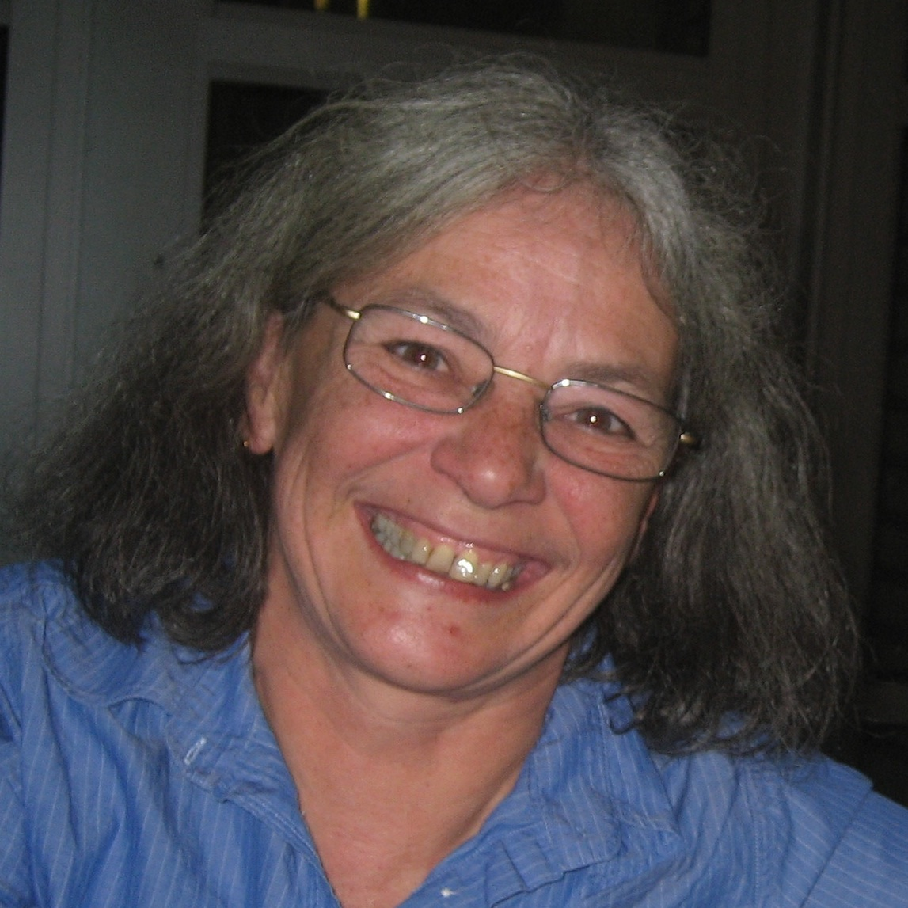


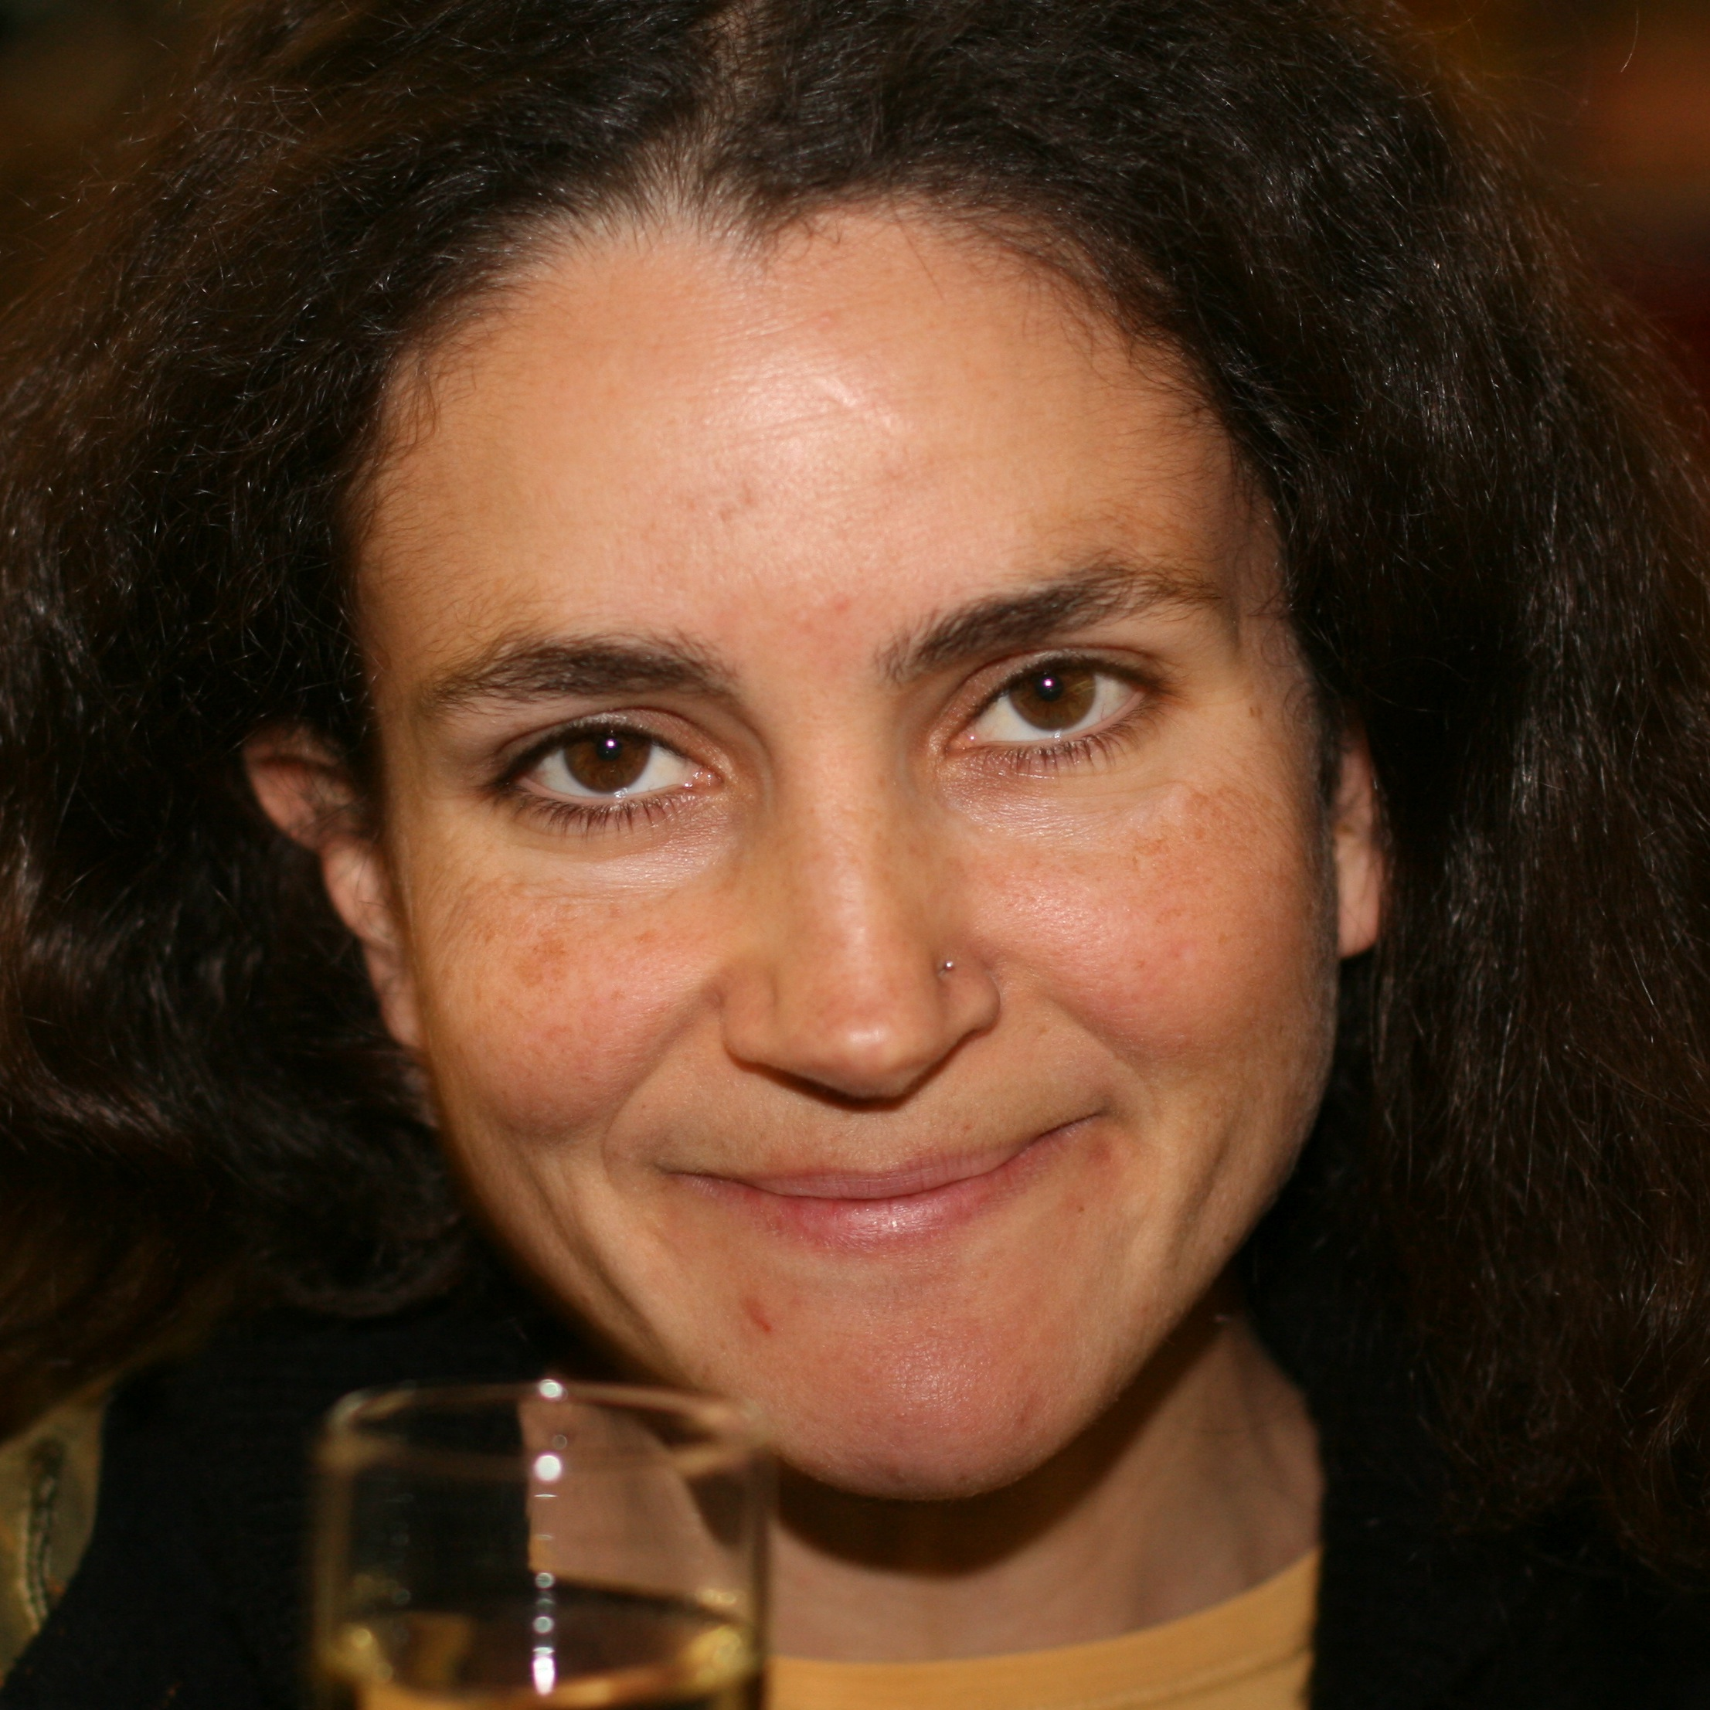

Acknowledgments
Anne Bergeron
Paul Medvedev
Eyla Willing
Marília D. V. Braga
Julia Mixtacki

Slide 39
Thank you!

